Slide 1
Model Market Irrationality with Bitcoin and Other Cryptocurrencies Final Presentation
Group 15:
Gang Ping Zhu
John Pak
Yiran Fan

Slide 2
Project Overview
Analyze the most valued cryptocurrencies in the market:
BTC
LTC
XRP
ETH
Use behavioral finance theories to answer the following questions:
How will the market volatility impact of cryptocurrency impact the financial system?
What are the correlations between currency and cryptocurrency?
How to measure cryptocurrency stability and the behavior’s of the investors of cryptocurrency?

Slide 3
Methodology
Initially started with research on the existing literature on cryptocurrency
Exploratory analysis and trends within the cryptocurrencies selected (BTC, LTC, ETH, XRP)
Analyzed data and trends between currency and cryptocurrency (e.g. Start exploring a historic volatility for crypotocurrency and currencies)
Established criteria between investments and currencies
Calculated and measured illiquidity and the index of Martin for our selected cryptocurrencies
Ran different models against our cryptocurrencies (ARMA, GARCH, Decision Tree, Random Forest)
Refined our models
Analyzed sentiment analysis of the market over the same period of time
Incorporated investor behavior impacts to refine our models further
Create predictions on stability based on our research of currency and invest behavior

Slide 4
Process, Tools, & Sources
Process for the data being used in our research
Data is pulled from https://coinmarketcap.com using the cryptoCMD API
Data is also pulled from European Central Bank Feed for currency exchange rates
Pull in sentiment data from https://www.aaii.com/sentimentsurvey
Data is joined and then cleansed in order to start analysis
Run calculations on the current data
Run models on the our data
Refine our models
Packages used:
scikit-learn
SciPy

Slide 5
Final Presentation
Prices From 1/1/2014 – 12/31/2015
Prices From 1/1/2016 – 4/24/2018
Large positive skewness (greater than 1) implies that the mean returns fall above the median returns
High kurtosis (greater than 3) implies a higher number of fat tails

Slide 6
Final Presentation
% Change of Volume and ROI From 1/1/2014 – 12/31/2015
% Change of Volume and ROI From 1/1/2016 – 4/24/2018
Money/Currency vs. Investment
Money/Currency = Easily Transferrable and High Volume
Investment = Volatile Price Fluctuations and Return on Investment (ROI)

Slide 7
Final Presentation
Min and Max Rank From 1/1/2016 – 4/24/2018
BTG experienced greatest variance in rank
BCC does not experience change in rank; however, remains top 25 in terms of market capitalization

Slide 8
Objective of the Study
Explore time-series models and fit the models on cryptocurrencies data
ARMA
GARCH
Examine how behavior finance factors influence returns/volatility of cryptocurrencies
Prospect Theory
Herding Behavior
Reconciliate our results with results from published papers

Slide 9
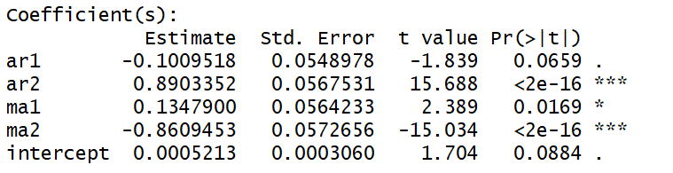
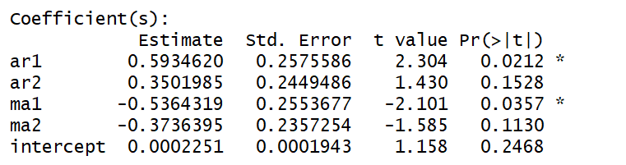
ARMA Model
ARIMA models work best for Bitcoin and Litecoin
Here are two results from ARMA(2,2). Bitcoin results is on the left while Litecoin is on the right. It is easy to see that two AR coefficients and two MA coefficients are significant for Bitcoin and only AR(1) and MA(1) are significantly for Litecoin.
However, none of the coefficients are significant for Ethereum and XRP. This is certainly unexpected.
Bitcoin
Litecoin

Slide 10
GARCH and Model Comparison
We further optimize the fitting of ARIMA model on cryptocurrencies. For instance, using Hyndman-Khandakar algorithm, we decide that ARIMA(3,0,3) is the best model for Bitcoin. In addition, we fit cryptocurrencies on a standard GARCH model.
This table presents the results for model comparison. The comparison is between optimized ARIMA model and GARCH model. For instance, the best model for Bitcoin is GARCH since it has higher log likelihood and lower AIC
Log Likelihood
 | BTC | ETH | LTC | XRP
ARIMA | 4302.85 | 9.57 | 2334.6 | 1879.6
GARCH | 5148.935 | 8.258826 | 1982.948 | 2596.224
AIC
 | BTC | ETH | LTC | XRP
ARIMA | -8589.7 | -11.4 | -4663.2 | -3751.2
GARCH | -10293.9 | -7.48078 | -3953.89 | -5180.43

Slide 11
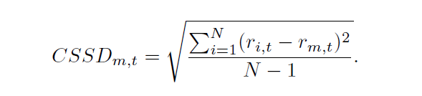
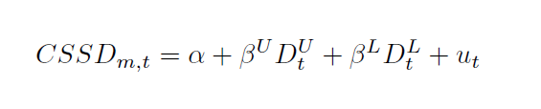
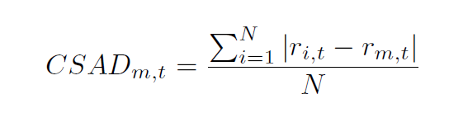
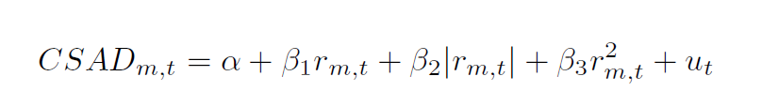
Testing for Herding Behavior
Generally, there are two methods to test for herding behavior
Cross-Sectional Standard Deviation (CSSD). Herding behavior exists if any beta is negative and statistically significant.
Cross-Sectional Absolute Deviation of Returns (CASD). Herding behavior exists if beta_3 is negative and statistically significant.

Slide 12
Testing Results
Results are very surprising. Many published papers state that herding behavior exists in cryptocurrencies. However, our results are contrary to their finding.
Since Lower is statistically significant at 5%, CSSD suggests that rational asset pricing model can explains the returns when returns are at extreme lower tails.
Since squared market return is strongly positive and statistically significant at 5%, CASD also suggests that rational asset pricing model works.
CSSD |  |  | CASD
 | Estimate | P-Value |  | Estimate | P-Value
Upper | -0.0011 | 0.9704 | Market Return | 0.0092 | 0.9560
Lower | 0.0861 | 0.0011 | Market Return Absolute | -1.1564 | 0.0200
 |  |  | Market Return Squared | 0.6143 | 0.0024

Slide 13
Potential Explanations for Testing Results
Potential Explanation 1: Herding behavior only exists during market upturn or downturn. Test this assumptions with a modified CASD model from (Chiang & Zhang, 2010). D is 1 if market return is less than 0 and 0 otherwise.
However, results are the same with CSSD. Since beta 4 is strongly positive and statistically significant, Under extreme lower tail return, rational asset pricing model can explain the returns while herding cannot.
Potential Explanation 2: Portfolio of cryptocurrencies used in testing. Largest cryptocurrencies are driving smaller cryptocurrencies, but not themselves.
 | Beta 1 | Beta 2 | Beta 3 | Beta 4
Estimate | -0.3103 | 1.3214 | 0.0564 | 0.7140
P-Value | 0.6611 | 0.0217 | 0.8887 | 0.0007

Slide 14
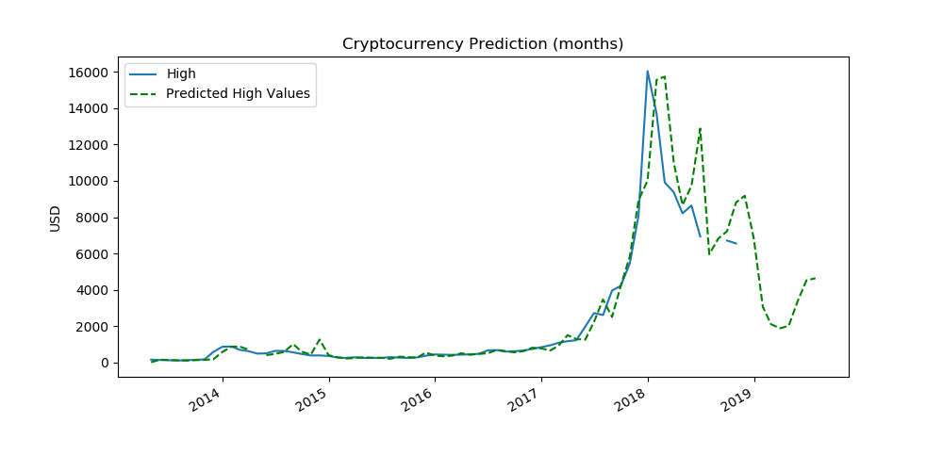
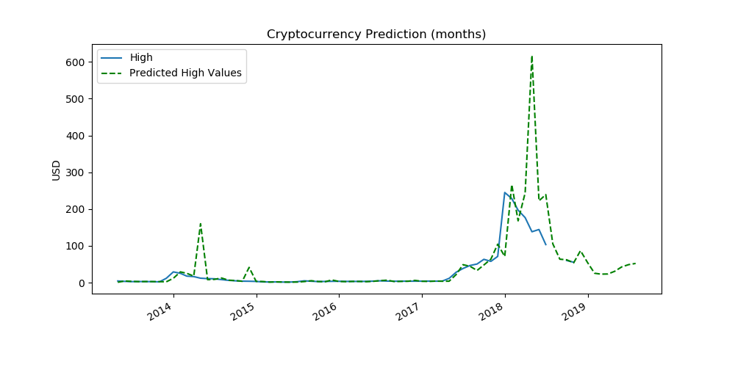
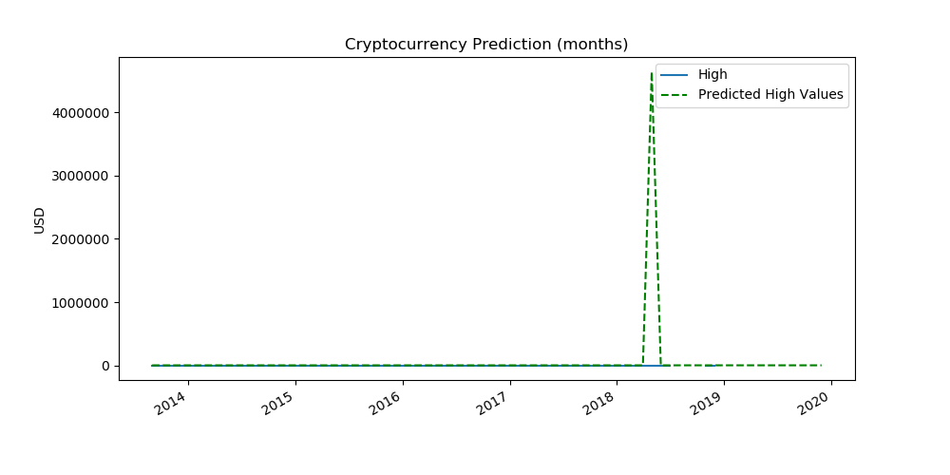
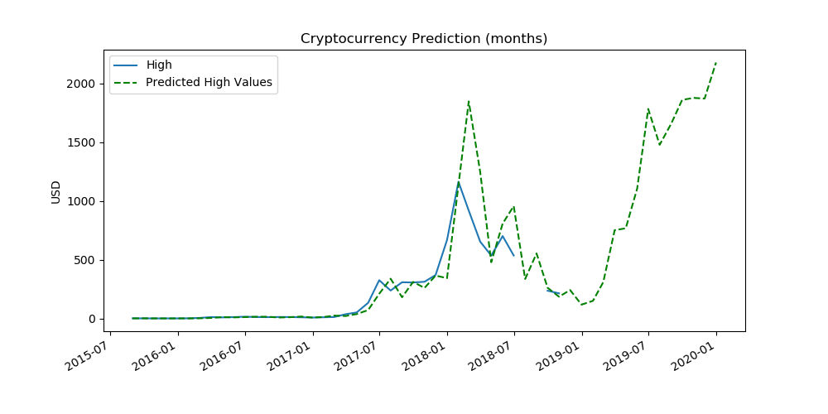
Predictions
The predictions below are based on including investor behavior as a variable in our data incorporating the initial refinement for a best model.
BTC LTC
XRP ETH

Slide 15
Thank you
Q&A

